Slide 1
Graph Introduction

Slide 2
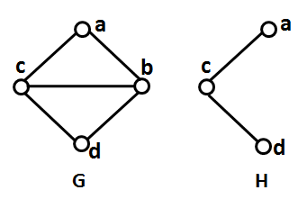
Graph
A graph G consists of two sets, V_{G}, whose elements are called vertices (or nodes), and E_{G}, whose elements are called edges. An edge e=(u, v) is said to join its end vertices.
Subgraph
A subgraph of a graph G is a graph H such that V_{H} ⊆ V_{G} and E _{H} ⊆ E_{G}.
V_{G}={a, b, c, d}, V_{H}={a, c, d}
E_{G} = {(a,b), (a,c), (b,c), (b,d), (c,d)}, E_{H} = {(a,c), (c,d)}
Notes:
Here, some of the basic definitions which are helpful to get clear idea on proposed work
A graph is a set of nodes and links (or vertices and edges), where the nodes and/or links can have arbitrary labels, and the links can be directed or undirected.

Slide 3
Graphs
A graph consists of a set of nodes connected by edges.
Graphs can model:
Sites and links on the web
Disease outbreaks
Social networks
Geographies
Task and dependency graphs
and more…
4

Slide 4
Graphs
A graph consists of a set of nodes connected by edges.
Nodes: degree (# connected edges) Nodes: in-degree (directed, # in- edges)
Nodes: out-degree (directed, # out- edges)
Path: sequence of nodes/edges from one node to another
Path: node x is reachable from node y
if a path exists from y to x.
Path: a cycle is a path that starts and ends at the same node
Path: a loop is an edge that connects a node to itself
4

Slide 5
Graphs
A graph consists of a set of nodes connected by edges.
Nodes: degree (# connected edges) Nodes: in-degree (directed, # in- edges)
Nodes: out-degree (directed, # out- edges)
5
3
2
6
Path: sequence of nodes/edges from one node to another
Path: node x is reachable from node y
if a path exists from y to x.
Path: a cycle is a path that starts and ends at the same node
Path: a loop is an edge that connects a node to itself
1
1
5

Slide 6
Graphs
A graph consists of a set of nodes connected by edges.
Nodes: degree (# connected edges) Nodes: in-degree (directed, # in- edges)
Nodes: out-degree (directed, # out- edges)
2
1
2
2
Path: sequence of nodes/edges from one node to another
Path: node x is reachable from node y
if a path exists from y to x.
Path: a cycle is a path that starts and ends at the same node
Path: a loop is an edge that connects a node to itself
1
1
6

Slide 7
Graphs
A graph consists of a set of nodes connected by edges.
Nodes: degree (# connected edges) Nodes: in-degree (directed, # in- edges)
Nodes: out-degree (directed, # out- edges)
3
2
0
4
Path: sequence of nodes/edges from one node to another
Path: node x is reachable from node y
if a path exists from y to x.
Path: a cycle is a path that starts and ends at the same node
Path: a loop is an edge that connects a node to itself
0
0
7

Slide 8
Graphs
A graph consists of a set of nodes connected by edges.
Nodes: degree (# connected edges) Nodes: in-degree (directed, # in- edges)
Nodes: out-degree (directed, # out- edges)
A
C
B
D
Path: sequence of nodes/edges from one node to another
Path: node x is reachable from node y
if a path exists from y to x.
Path: a cycle is a path that starts and ends at the same node
Path: a loop is an edge that connects a node to itself
F
E
8

Slide 9
Graphs
A graph consists of a set of nodes connected by edges.
Nodes: degree (# connected edges) Nodes: in-degree (directed, # in- edges)
Nodes: out-degree (directed, # out- edges)
A
C
B
D
Path: sequence of nodes/edges from one node to another
Path: node x is reachable from node y
if a path exists from y to x.
Path: a cycle is a path that starts and ends at the same node
Path: a loop is an edge that connects a node to itself
F
E
9

Slide 10
Graphs
A graph consists of a set of nodes connected by edges.
Nodes: degree (# connected edges) Nodes: in-degree (directed, # in- edges)
Nodes: out-degree (directed, # out- edges)
A
C
B
D
Path: sequence of nodes/edges from one node to another
Path: node x is reachable from node y
if a path exists from y to x.
Path: a cycle is a path that starts and ends at the same node
Path: a loop is an edge that connects a node to itself
F
E
10

Slide 11
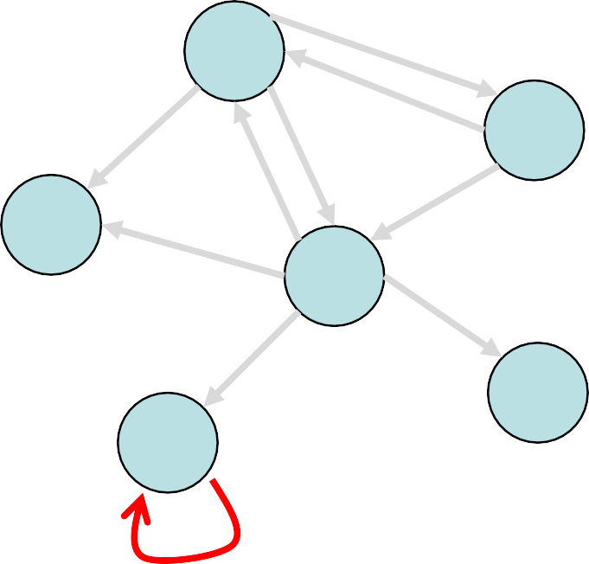
Graphs
A graph consists of a set of nodes connected by edges.
Nodes: degree (# connected edges) Nodes: in-degree (directed, # in- edges)
Nodes: out-degree (directed, # out- edges)
A
C
B
D
Path: sequence of nodes/edges from one node to another
Path: node x is reachable from node y
if a path exists from y to x.
Path: a cycle is a path that starts and ends at the same node
Path: a loop is an edge that connects a node to itself
F
E
11

Slide 12


Graph Properties
A graph is connected if every node is reachable from every other node.
12

Slide 13
Graph Properties
A graph is complete if every node has a direct edge to every other node.
undirected graph, with n nodes , maximum no. edges=10 5X4= 20 N X (N-1) /2
directed graph, N X N-1 ,
13

Slide 14
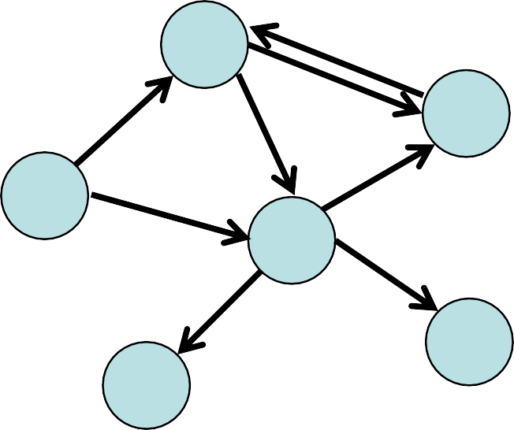
Graph Properties
A graph is directed if its edges have direction, or undirected if its edges do not have direction.
directed
undirected
14

Slide 15
2 Edge Types
Directed edge (ARROW)
ordered pair of vertices (u,v)
first vertex u is the origin
second vertex v is the destination
e.g., a flight
Undirected edge (no arrow)
unordered pair of vertices (u,v)
e.g., a flight route
Directed graph
all the edges are directed
e.g., route network
Undirected graph
all the edges are undirected
e.g., flight network
flight
AA 1206
ORD
PVD
849
miles
ORD
PVD
A road between two points
Could be one way (directed)
Or two way (undirected)
Could have more than one edge
(e.g. toll road and public road)

Slide 16
Terminology
End vertices (or endpoints) of an edge
U and V are the endpoints of a
Edges incident on a vertex
a, d, and b are incident on V
Adjacent vertices
U and V are adjacent
Degree of a vertex
X has degree 5
Parallel edges
h and i are parallel edges / multi edges
Self-loop
j is a self-loop
V
a
b
h
j
U
d
X
Z
c
e
i
W
g
f
Y

Slide 17
Terminology (cont.)
Path
sequence of alternating vertices and edges
begins with a vertex
ends with a vertex
each edge is preceded and followed by its endpoints
Simple path
path such that all its vertices and edges are distinct
Examples
P₁=(V,b,X,h,Z) is a simple path
P₂=(U,c,W,e,X,g,Y,f,W,d,V) is a path that is not simple
V
a
b
P₁
d
U
X
Z
P₂
h
c
e
W
g
f
Y

Slide 18
Terminology (cont.)
Cycle
circular sequence of alternating vertices and edges
each edge is preceded and followed by its endpoints
Simple cycle
cycle such that all its vertices and edges are distinct
Examples
C₁=(V,b,X,g,Y,f,W,c,U,a,↵) is a simple cycle
C₂=(U,c,W,e,X,g,Y,f,W,d,V,a,↵) is a cycle that is not simple
V
a
b
d
U
X
Z
C₂
h
e
C₁
c
W
g
f
Y

Slide 19
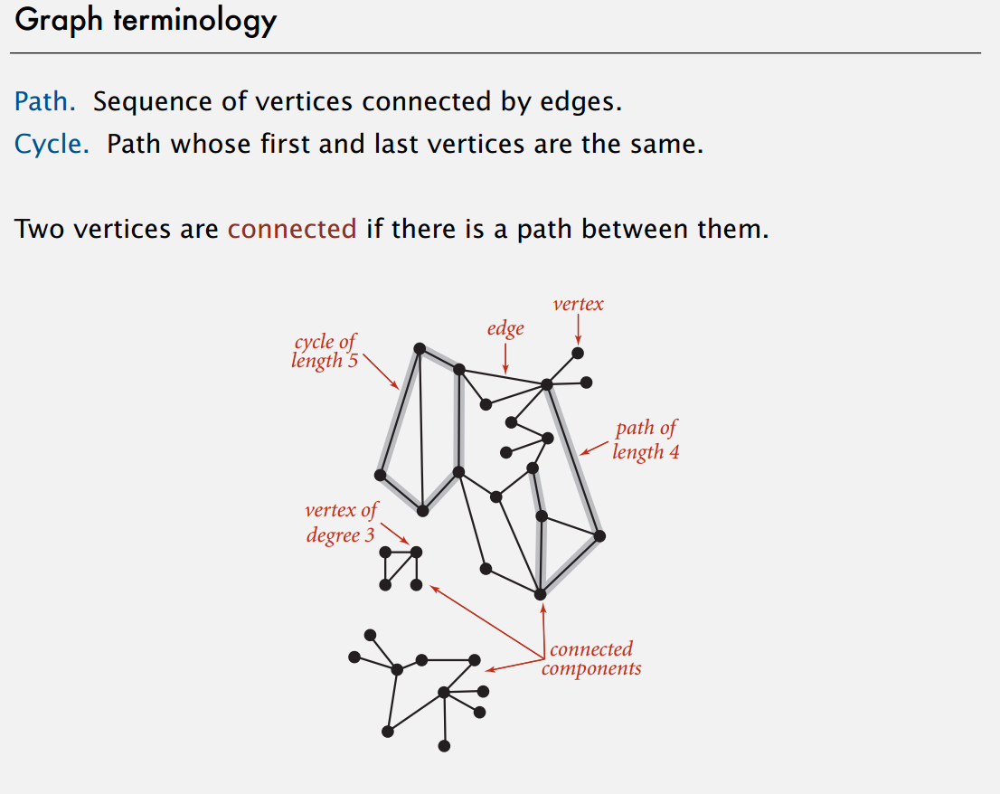

Slide 20
Properties
Property 1 (handshakes)
Σ_{v} deg(v) = 2m
Proof: each edge is counted twice
Notation
n number of vertices
m number of edges
deg(v) degree of vertex v
Example
n = 4
m = 6
deg(v) = 3

Slide 21
Properties
Property 1
Σ_{v} deg(v) = 2m
Proof: each edge is counted twice
Property 2
In an undirected graph with no self-loops and no multiple edges
m ≤ n (n − 1)/2
Proof: each vertex has degree at most (n − 1)
What is the bound for a directed graph?
Notation
n number of vertices
m number of edges
deg(v) degree of vertex v
Example
n = 4
m = 6
deg(v) = 3

Slide 22
Subgraphs
A subgraph S of a graph G is a graph such that
The vertices of S are a subset of the vertices of G
The edges of S are a subset of the edges of G
A spanning subgraph of G is a subgraph that contains all the vertices of G
Subgraph
Spanning subgraph

Slide 23
Connectivity
A graph is connected if there is a path between every pair of vertices
A connected component of a graph G is a maximal connected subgraph of G
Connected graph
Non connected graph with two connected components

Slide 24
Trees and Forests
A (free) tree is an undirected graph T such that
T is connected
T has no cycles
This definition of tree is different from the one of a rooted tree
A forest is an undirected graph without cycles
The connected components of a forest are trees
Tree
Forest

Slide 25
Implementing a Graph
To program a graph data structure, what information would we need to store?
For each vertex?
For each edge?
2
1
3
7
4
6
5

Slide 26
Implementing a Graph
What kinds of questions would we want to be able to answer (quickly?) about a graph G?
Where is vertex v?
Which vertices are adjacent to vertex v?
What edges touch vertex v?
What are the edges of G?
What are the vertices of G?
What is the degree of vertex v?
2
1
3
7
4
6
5

Slide 27
Graph Implementation Strategies
Edge List
Adjacency Matrix
Adjacency List

Slide 28
Edge List
edge list: an unordered list of all edges in the graph
2
1
3
1
1
1
2
2
3
5
5
5
7
7
2
5
6
7
3
4
6
7
4
4
4
6
5

Slide 29
Edge List: Pros and Cons
advantages
easy to loop/iterate over all edges
disadvantages
hard to tell if an edge exists from A to B
hard to tell how many edges a vertex touches (its degree)
1
1
1
2
2
3
5
5
5
7
2
5
6
7
3
4
6
7
4
4

Slide 30
Adjacency Matrix Example
How do we figure out the degree of a given vertex?
How do we find out whether an edge exists from A to B?
How could we look for loops in the graph?
2
1 2 3 4 5 6 7
1
3
1
2
3
4
5
6
7
0
1
0
0
1
1
0
1
0
1
0
0
0
1
7
0
1
0
1
0
0
0
0
0
1
0
1
0
1
4
1
0
0
1
0
1
1
1
0
0
0
1
0
0
6
0
1
0
1
1
0
0
5

Slide 31
Adjacency Matrix
adjacency matrix: an n × n matrix where:
the nondiagonal entry a_{ij} is the number of edges joining vertex i and vertex j (or the weight of the edge joining vertex i and vertex j)
the diagonal entry a_{ii} corresponds to the number of loops (self-connecting edges) at vertex i

Slide 32
Adjacency Matrix: Pros and Cons
advantages
fast to tell whether edge exists between any two vertices i and j (and to get its weight)
disadvantages
consumes a lot of memory on sparse graphs (ones with few edges)
redundant information for undirected graphs

Slide 33
Adjacency List Example
How do we figure out the degree of a given vertex?
How do we find out whether an edge exists from A to B?
How could we look for loops in the graph?
2
1
3
1
2
3
4
5
6
7
2
5
6
3
1
7
2
4
7
3
7
5
6
1
7
4
4
1
5
6
4
5
2
5

Slide 34
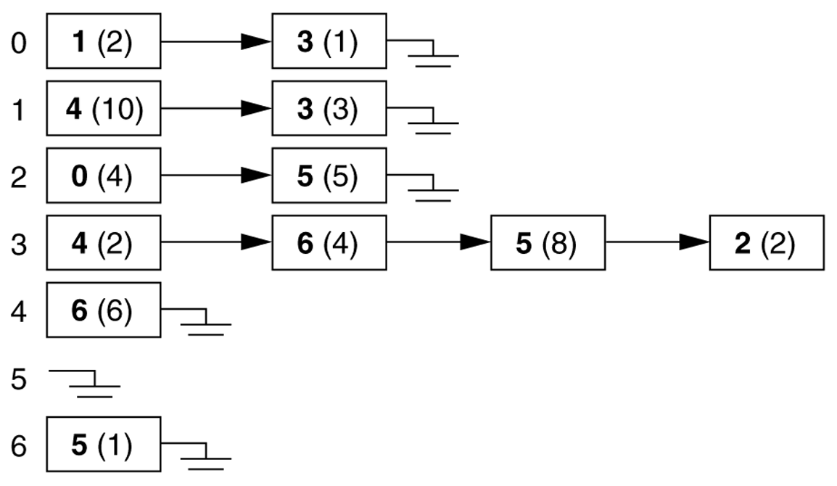
Adjacency Lists
adjacency list: stores edges as individual linked lists of references to each vertex's neighbors

Slide 35
Adjacency List: Pros and Cons
advantages:
new nodes can be added easily
new nodes can be connected with existing nodes easily
"who are my neighbors" easily answered
disadvantages:
determining whether an edge exists between two nodes: O(average degree)

Slide 36
Runtime table
n vertices, m edges no parallel edges no self-loops | Edge List | Adjacency List | Adjacency Matrix
Space
Finding all adjacent vertices to v
Determining if v is adjacent to w
adding a vertex
adding an edge
removing vertex v
removing an edge
n vertices, m edges no parallel edges no self-loops | Edge List | Adjacency List | Adjacency Matrix
Space | n + m | n + m | n²
Finding all adjacent vertices to v | m | deg(v) | n
Determining if v is adjacent to w | m | deg(v) | 1
adding a vertex | 1 | 1 | n²
adding an edge to v | 1 | 1 | 1
removing vertex v | m | n? | n²
removing an edge from v | m | deg(v) | 1

Slide 37
Breadth-First Search
Breadth-first search explores the nodes of a graph in increasing distance away from some starting vertex s.
It decomposes the component intolayers L_{i} such that the shortest path from s to each of nodes in L_{i} is of length i .
Breadth-First Search:
L₀ is the set {s}.
Given layers L₀, L₁, . . . , L_{j} , then L_{j +1} is the set of nodes that are not in a previous layer and that have an edge to some node in layer L_{j} .

Slide 38



BFS Tree
s
1
2
3
4
5
6
7
8 9
10 11 12 13 14 15 16

Slide 39
Breadth-First Search (BFS)
3
begins at a root node and inspects all the neighboring nodes. Then for each of those neighbor nodes in turn, it inspects their neighbor nodes which were unvisited, and so on

Slide 40
Breadth-First Search (BFS)
4
B
D
A
C
E
S
F
Queue: visited nodes
A B S A
B S A B
S CG A B S
C G D E F A B S C
G D E F H A B S C G
D E F H A B S C G D
E F H A B S C G D E
A B S C G D E F H
G
H

Slide 41

Breadth-First Search (BFS)
5
B
D
A
C
E
S
F
G
H

Slide 42
Breadth-First Search (BFS)
6
B
D
A
C
E
S
F
G
H

Slide 43
Breadth-First Search (BFS)
7
B
D
A
C
E
S
F
G
H

Slide 44

Breadth-First Search (BFS)
8
B
D
A
C
E
S
F
G
H

Slide 45

Breadth-First Search (BFS)
9
B
D
A
C
E
S
F
G
H

Slide 46
Breadth-First Search (BFS)
10
B
D
A
C
E
S
F
G
H

Slide 47
Breadth-First Search (BFS)
11
B
D
A
C
E
S
F
G
H

Slide 48

Breadth-First Search (BFS)
12
B
D
A
C
E
S
F
G
H

Slide 49
Breadth-First Search (BFS)
13
B
D
A
C
E
S
F
G
H

Slide 50
Breadth-First Search (BFS)
14
B
D
A
C
E
S
F
G
H

Slide 51

Breadth-First Search (BFS)
15
B
D
A
C
E
S
F
G
H

Slide 52
Breadth-First Search (BFS)
16
B
D
A
C
E
S
F
G
H
{A B S C G D E F H}
A B S C G D E F H

Slide 53







Tree after BFS run
17
A
B
S
C
G
D E
F
H

Slide 54
BFS running time
19
If we represent the graph G by adjacency matrix then the running time of BFS algorithm is O(n² ), where n is the number of nodes.
If we represent the graph G by link lists then the running time of BFS algorithm is O(m + n), where m is the number of edges and n is the number of nodes.

Slide 55
h/w: BFS Tree Example
A BFS traversal of a graph results in abreadth-first search tree:
2
1
3
s
2
3
1
3

Slide 56
BFS Tree Example
A BFS traversal of a graph results in abreadth-first search tree:
2
1
3
s
2
3
1
3
Can we say anything about the non-tree edges?

Slide 57
Depth-First Search
DFS keeps walking down a path until it is forced to backtrack.
s
It backtracks until it finds a new path to go down.
1
Think: Solving a maze.
2
It results in a search tree, called thedepth-first search tree.
3
4
In general, the DFS tree will be very different than the BFS tree.
5
7
6

Slide 58
Depth-First Search (DFS)
21
 We don’t visit the nodes level by level! As long as there is an unvisited node adjacent to the current visited node we continue! Once we are stuck, trace back and go to a different branch!

Slide 59
Depth-First Search (DFS)
B
D
22
Stack: visited
A SB A
B S A B
S G C A B S
C G F E D A B S C
D G F E A B S C D
E G F H A B S C D
H G F A B S C D H
A B S C D H F G
A
C
E
S
F
G
H

Slide 60
Depth-First Search (DFS)
23
B
D
A
C
E
S
F
G
H

Slide 61
Depth-First Search (DFS)
24
B
D
A
C
E
S
F
G
H

Slide 62
Depth-First Search (DFS)
25
B
D
A
C
E
S
F
G
H

Slide 63
Depth-First Search (DFS)
26
B
D
A
C
E
S
F
G
H

Slide 64
Depth-First Search (DFS)
27
B
D
A
C
E
S
F
G
H

Slide 65
Depth-First Search (DFS)
28
B
D
A
C
E
S
F
G
H

Slide 66
Depth-First Search (DFS)
29
B
D
A
C
E
S
F
G
H

Slide 67
Depth-First Search (DFS)
30
B
D
A
C
E
S
F
G
H

Slide 68
Depth-First Search (DFS)
31
B
D
A
C
E
S
F
G
H
A B S C D H F G
{A B S C D E H G F}

Slide 69


Edges of G that are not in DFS
32
B
D
A
C
E
S
F
G
H

Slide 70





Tree after DFS run and edges in G
33
A
B
S
C
D E
H G F

Slide 71
DFS running time
36
If we represent the graph G by adjacency matrix then the running time of DFS algorithm is O(n² ), where n is the number of nodes.
If we represent the graph G by link lists then the running time of DFS algorithm is O(m + n), where m is the number of edges and n is the number of nodes.

Slide 72
Depth-First Search
2
1
3
s
5
4
7
6

Slide 73
BFS implementation
procedure bfs(G, s):
Q := queue containing only s
while Q not empty
v := Q.front(); Q.remove front()
for w ∈ G.neighbors(v):
if w not seen:
mark w seen Q.enqueue(w)

Slide 74
Recursive implementation of DFS
procedure dfs(G, u):
while u has an unvisited neighbor in G v := an unvisited neighbor of u mark v visited
dfs(G, v)

Slide 75
Stack-based implementation of DFS
procedure dfs(G, s):
S := stack containing only s
while S not empty v := S.pop()
if v not visited: mark v visited
for w ∈ G.neighbors(v): S.push(w)

